Slide 1
Wafer Mapping
Yifu Chen
Advisor: Darcy Barron

Slide 2
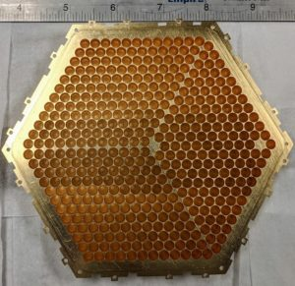

Slide 3
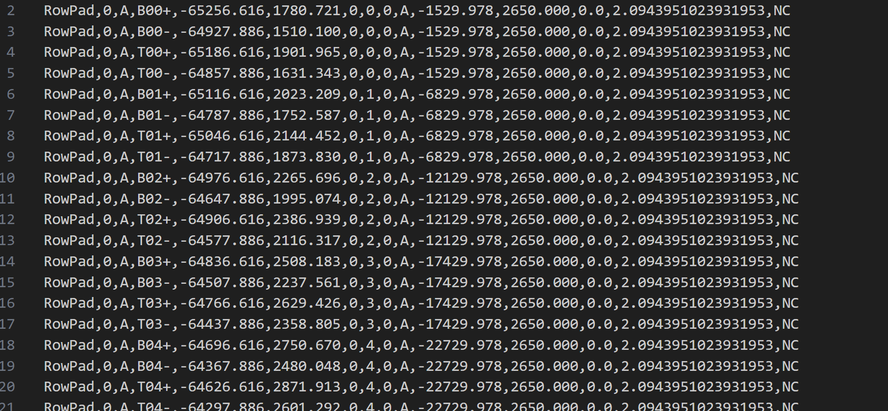
Grouptype,GroupIndex,Group Section,Pad Label,Pad X center,Pad Y center,Pixel Row,Pixel Column,Pixel Ring,Pixel Section,Pixel X center,Pixel Y center,Raw angle,Actual angle,Signal description

Slide 4
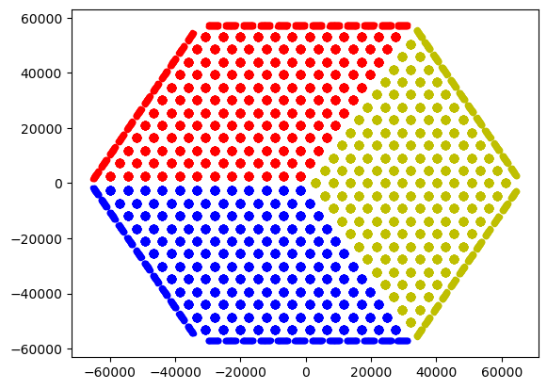

Slide 5
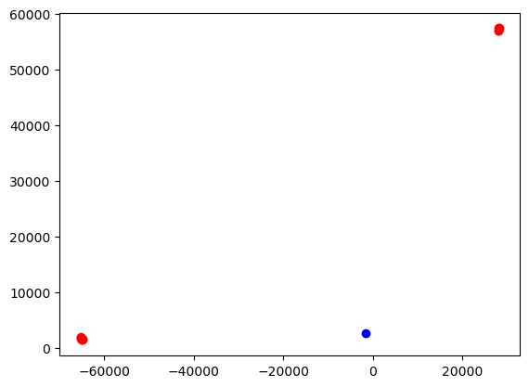
goal 1:
for each pixel,
what’s the distance between to the related pad

Slide 6
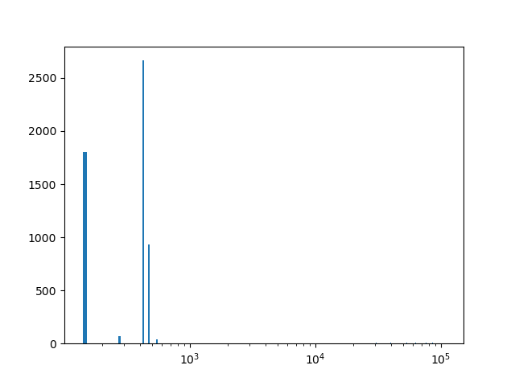
Histogram for goal1
Unit: μm

Slide 7
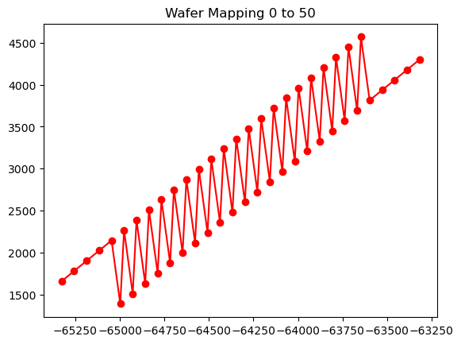
goal 2:
for the neighbor pad,
what’s the
distance between connected pixel
Pad in one group

Slide 8
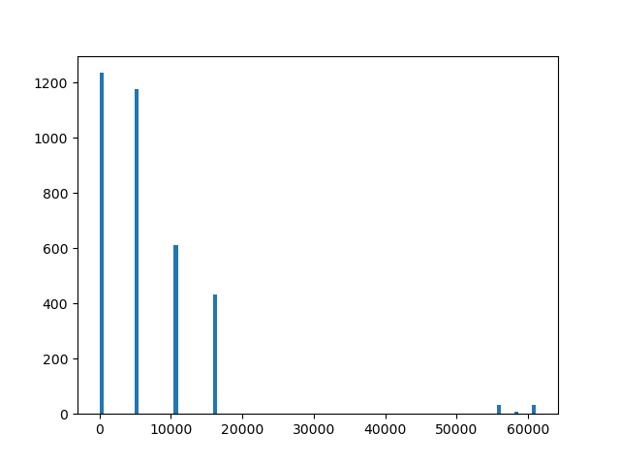
Histogram for goal2
Unit: μm

Slide 9

